Slide 1
Election Overview
General Election – Thursday 8 June 2017
650 Members of Parliament (MPs)
38 Drop off Points for Candidate Mail
  Primarily at Mail Centre Sites although RDC sites and former buildings are been used
WRIT Delivery – 4th May
Poll Card Postings – 6th May onwards
Candidate Mail – from 11th May
Ballot Pack Postings – from 22 May
Ballot Pack Returns – from 23 May
Added Value Services – from 23 May
Final Day Sweeps – 8th June
WRIT Returns – 9th June

Slide 2
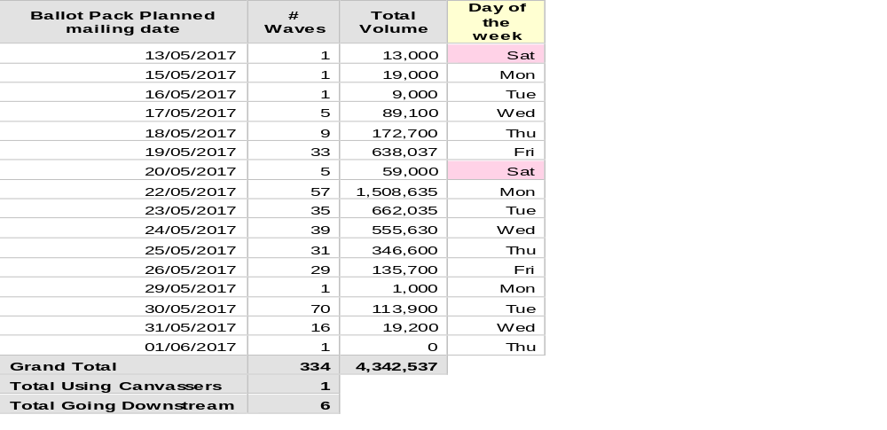
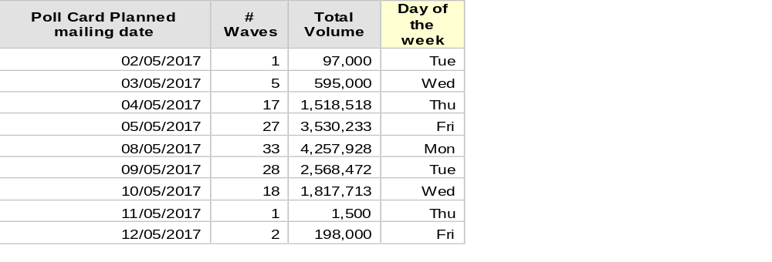
Poll Card & Ballot Pack Volumes
(%RM/DSA below ref May Election 2017)
Within the UK there are c40m Electorate
Poll Card Split as per the May Local Elections
Royal Mail – 46%
DSA – 36%
Canvasser – 18%
So we will ultimately deliver c32m Poll Cards
Ballot Packs, c4.3m Postal Voters in the UK

Slide 3
Products
 | PRODUCT | DELIVERY SPECIFICATION | DO UNIT PAYMENT
Poll Card | Poll Card Mailing | 3 days | Yes
 | Standard tariff | As posting product purchased | Yes
 | DSA | As posting product purchased | Yes
 | Canvasser | Delivered direct by LA or Agent | N/A
Ballot Packs (for people requisition postal votes) | Standard tariff | As posting product purchased | No
 | DSA | As posting product purchased | No
Postal Vote | Standard tariff | As posting product purchased | No
 | DSA | As posting product purchased | No

Slide 4
Campaign Mail
Campaign Mail also known as Candidate Literature, Candidate Mailings
Two types:
  Addressed
    - Electionsort
    - Streetsort
  Unaddressed

Slide 5
Candidate Mail Addressed
Addressed
  Electionsort – line listing to DO walk level
  Items arrive in walk order, minimal amount of IP required
  Streetsort
  Items arrive in street order, slightly higher level of IP could be required
  Product Spec - 3 days delivery, attracts item payment

Slide 6
Candidate Mail Unaddressed
Unaddressed
  - Items arrive in boxes or bags in bundles of 100
  Product Spec - 7 days delivery, attracts item payment

Slide 7
Candidate Mail Delivery Span
7 Days – Unaddressed Mail
Candidate/Printer
Royal Mail Drop Off Point
Delivery Office
Delivered to Voter
3 Days – Addressed Mail
Delivery Days are Monday to Friday

Slide 8
Election Overview
Now in pre-election period, (no political visits, announcements etc)
Unit payments for poll cards and candidates mailing (addressed and unaddressed) only
No payments for door to door, or other retail or wholesale postings from political parties
Candidates mail – 3 day addressed and 7 day unaddressed specification. Monday to Friday spec, Saturday not included.
Ensuring plans for ballot packs from printers in place and communicated
Common areas of complaints
Nesting
Split walks, delivering unaddressed candidates mail to DP in another constituency. Ensure all split walks clear which DPs are in which constituency
Election day delivery, last day for delivering any election material is Wednesday 7 June
Inaccurate or absent MI on mailing keep parties updated on progress through accurate reporting on Candidates Mailing Tracker (CMT) daily).

Slide 9
Election Contacts
For questions on election material:
Central/National – Joy Godbold – 07841 076354
East – Andrew Martin –07595 849216
North – Derek Keir – 07753 833393
South – Leanne Garner – 07841 076113
West – Richard Moulton – 07885 875628

